Slide 1
Open-Source and Institution-Specific Research Impact Evaluation via Unsupervised Ranking
Maria Tomasso, Emon Nooruddin, Melinda Villagran
Translational Health Research Center

Slide 2
Why This Problem?
The Challenge: Research Impact ≠ Citations
Slow feedback loops
Domain/language bias
Gaming metrics (e.g., JIF)
Notes:
The dominant signals we use for impact are noisy, biased, and delayed

Slide 3
Problem Formulation
Can we treat research impact as an unsupervised ranking problem?
Multiple dimensions of impact
No ground truth labels
Need for explainable, scalable models

Slide 4
Why Unsupervised?
No ground truth
Expert labeling infeasible at scale
Interpretability over prediction performance

Slide 5
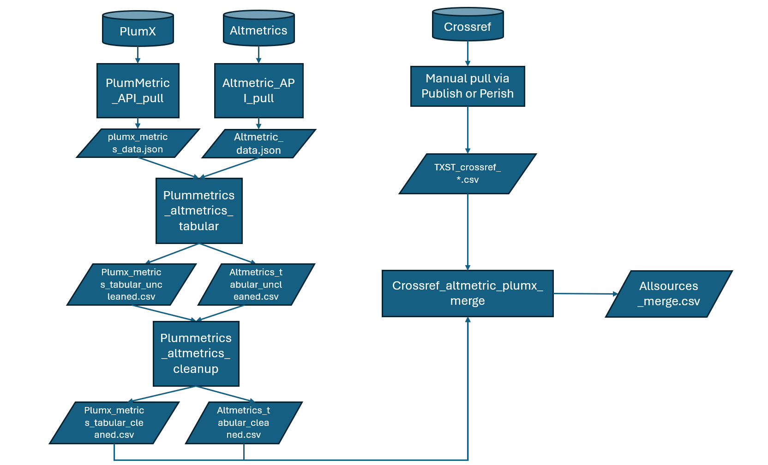
Data Pipeline
Crossref (bibliometrics)
PlumX + Altmetrics (altmetrics)
API-driven, DOI-matching

Slide 6
Data Preprocessing
Collect 25,000 papers with at least one author affiliated with TXST, published from 2000-2024
Normalize by publication age (impact/year)
Handle missing → set to zero
Address skew/kurtosis (cannot be transformed easily)

Slide 7
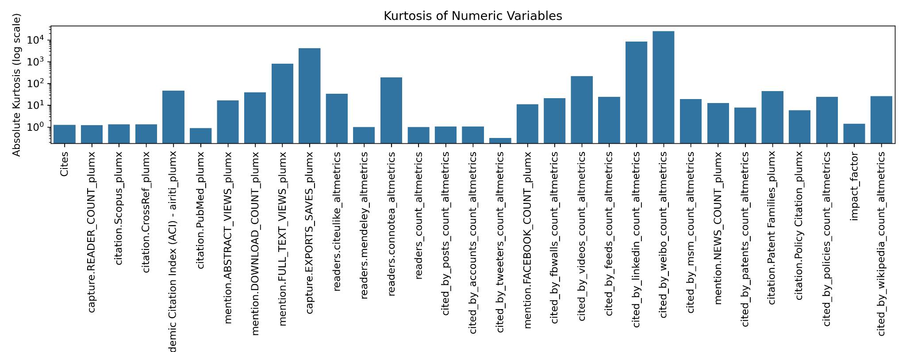
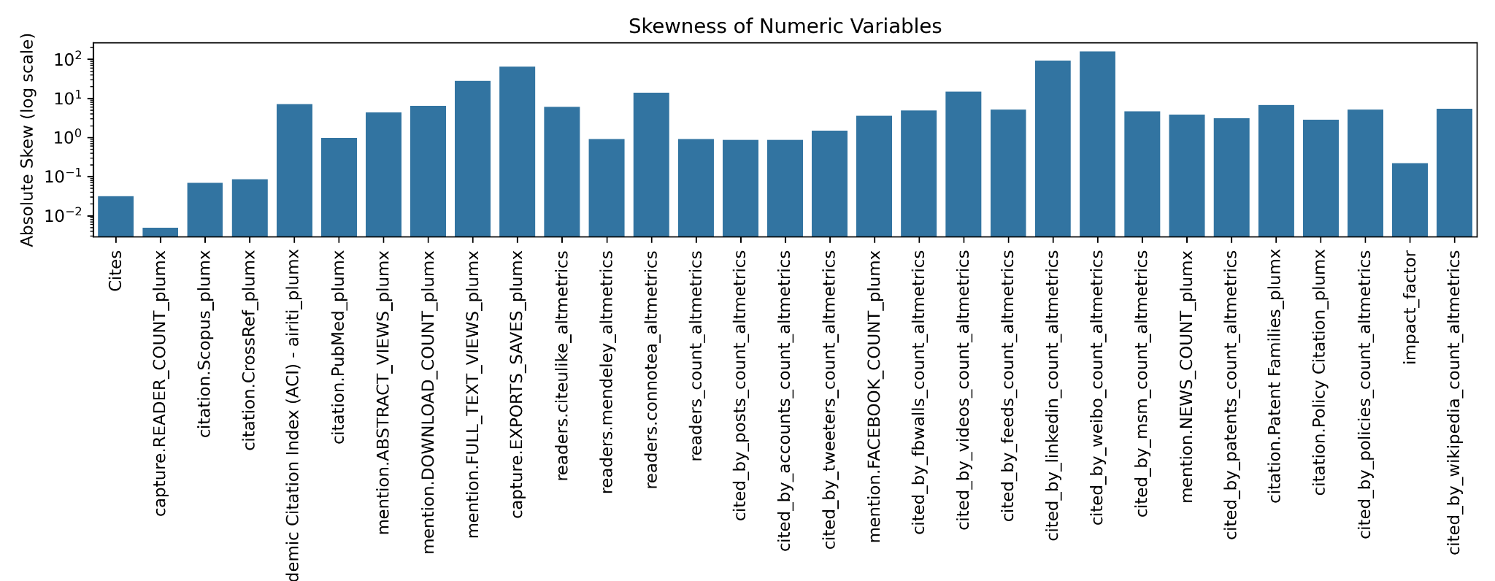
Kurtosis and Skew

Slide 8
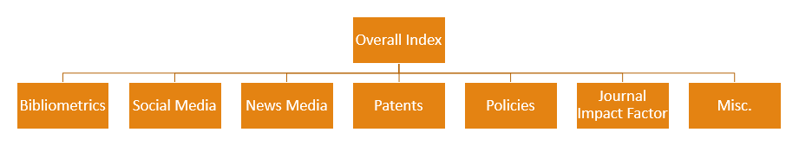
Method 1 – Composite Percentile Score
Inspired by Elsevier’s framework
7 subdomains, weighted:
Output: interpretable percentile-based index
Top n% can be labeled as high-impact

Slide 9
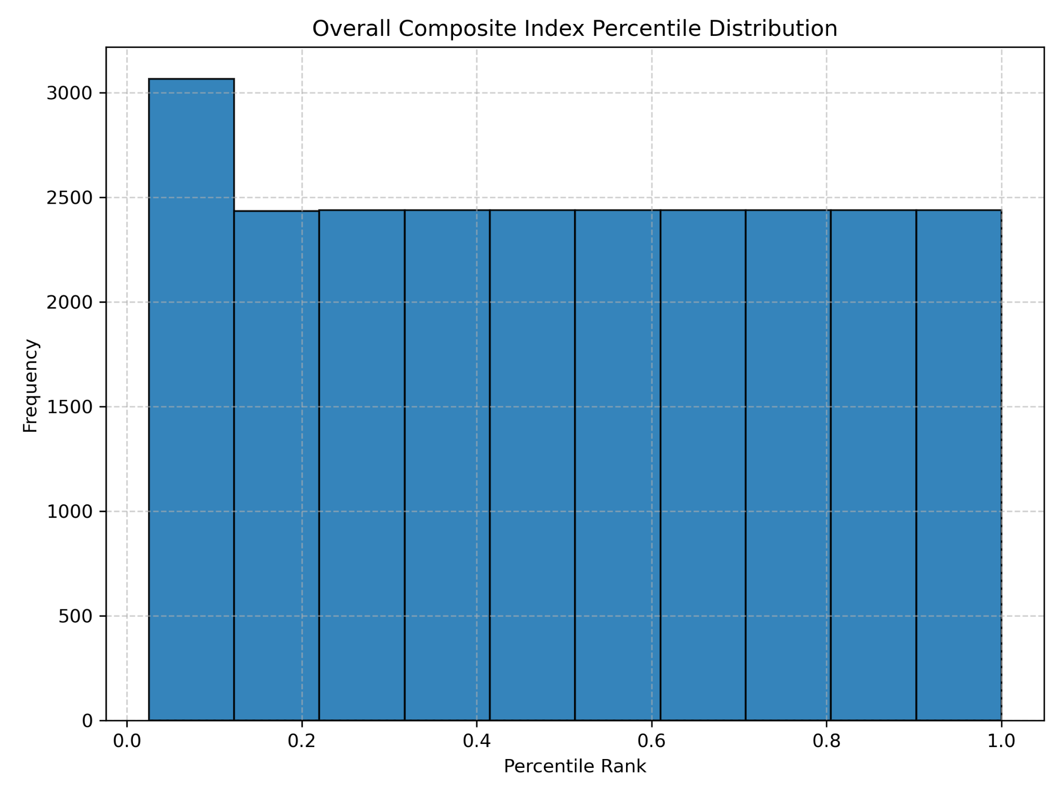
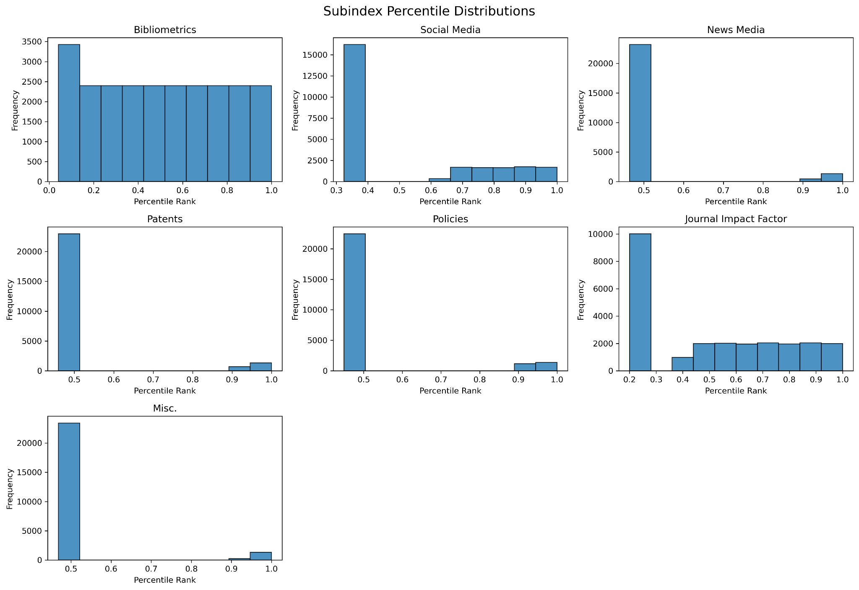
Method 1 Results

Slide 10
Method 2 – Pareto Front Ranking
Multi-objective optimization
No assumptions, no weights
Front 0 = nondominated set
Notes:
Emphasize CS relevance (e.g., used in evolutionary algorithms)

Slide 11
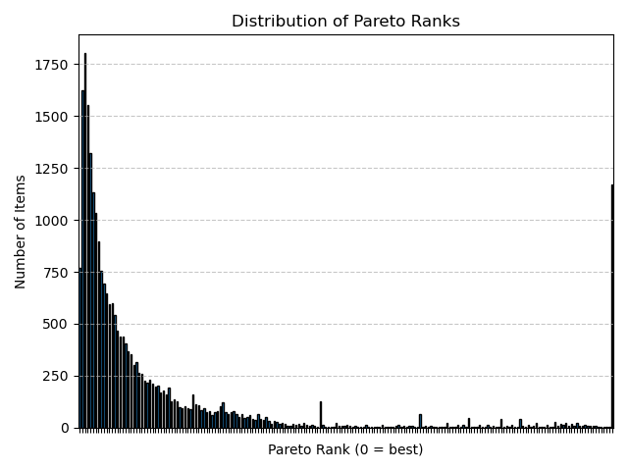
Method 2 Results

Slide 12
Method 3 – Cluster-Based Ranking
K-means (k=10), rank clusters by centroid sum
Robust to outliers, discretizes impact tiers
Useful for institutional benchmarking

Slide 13
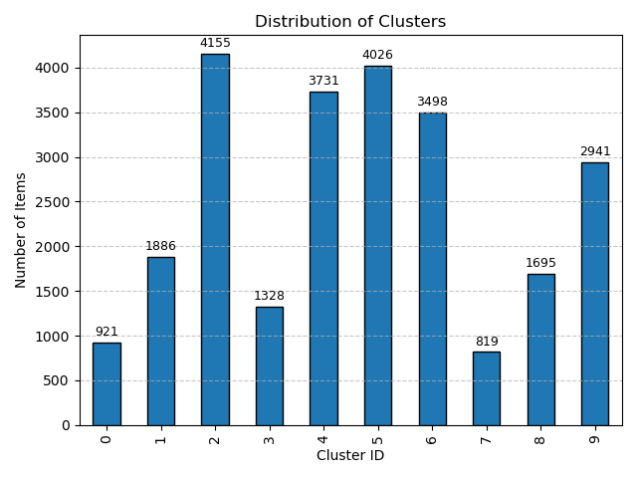
Method 3 - Results

Slide 14
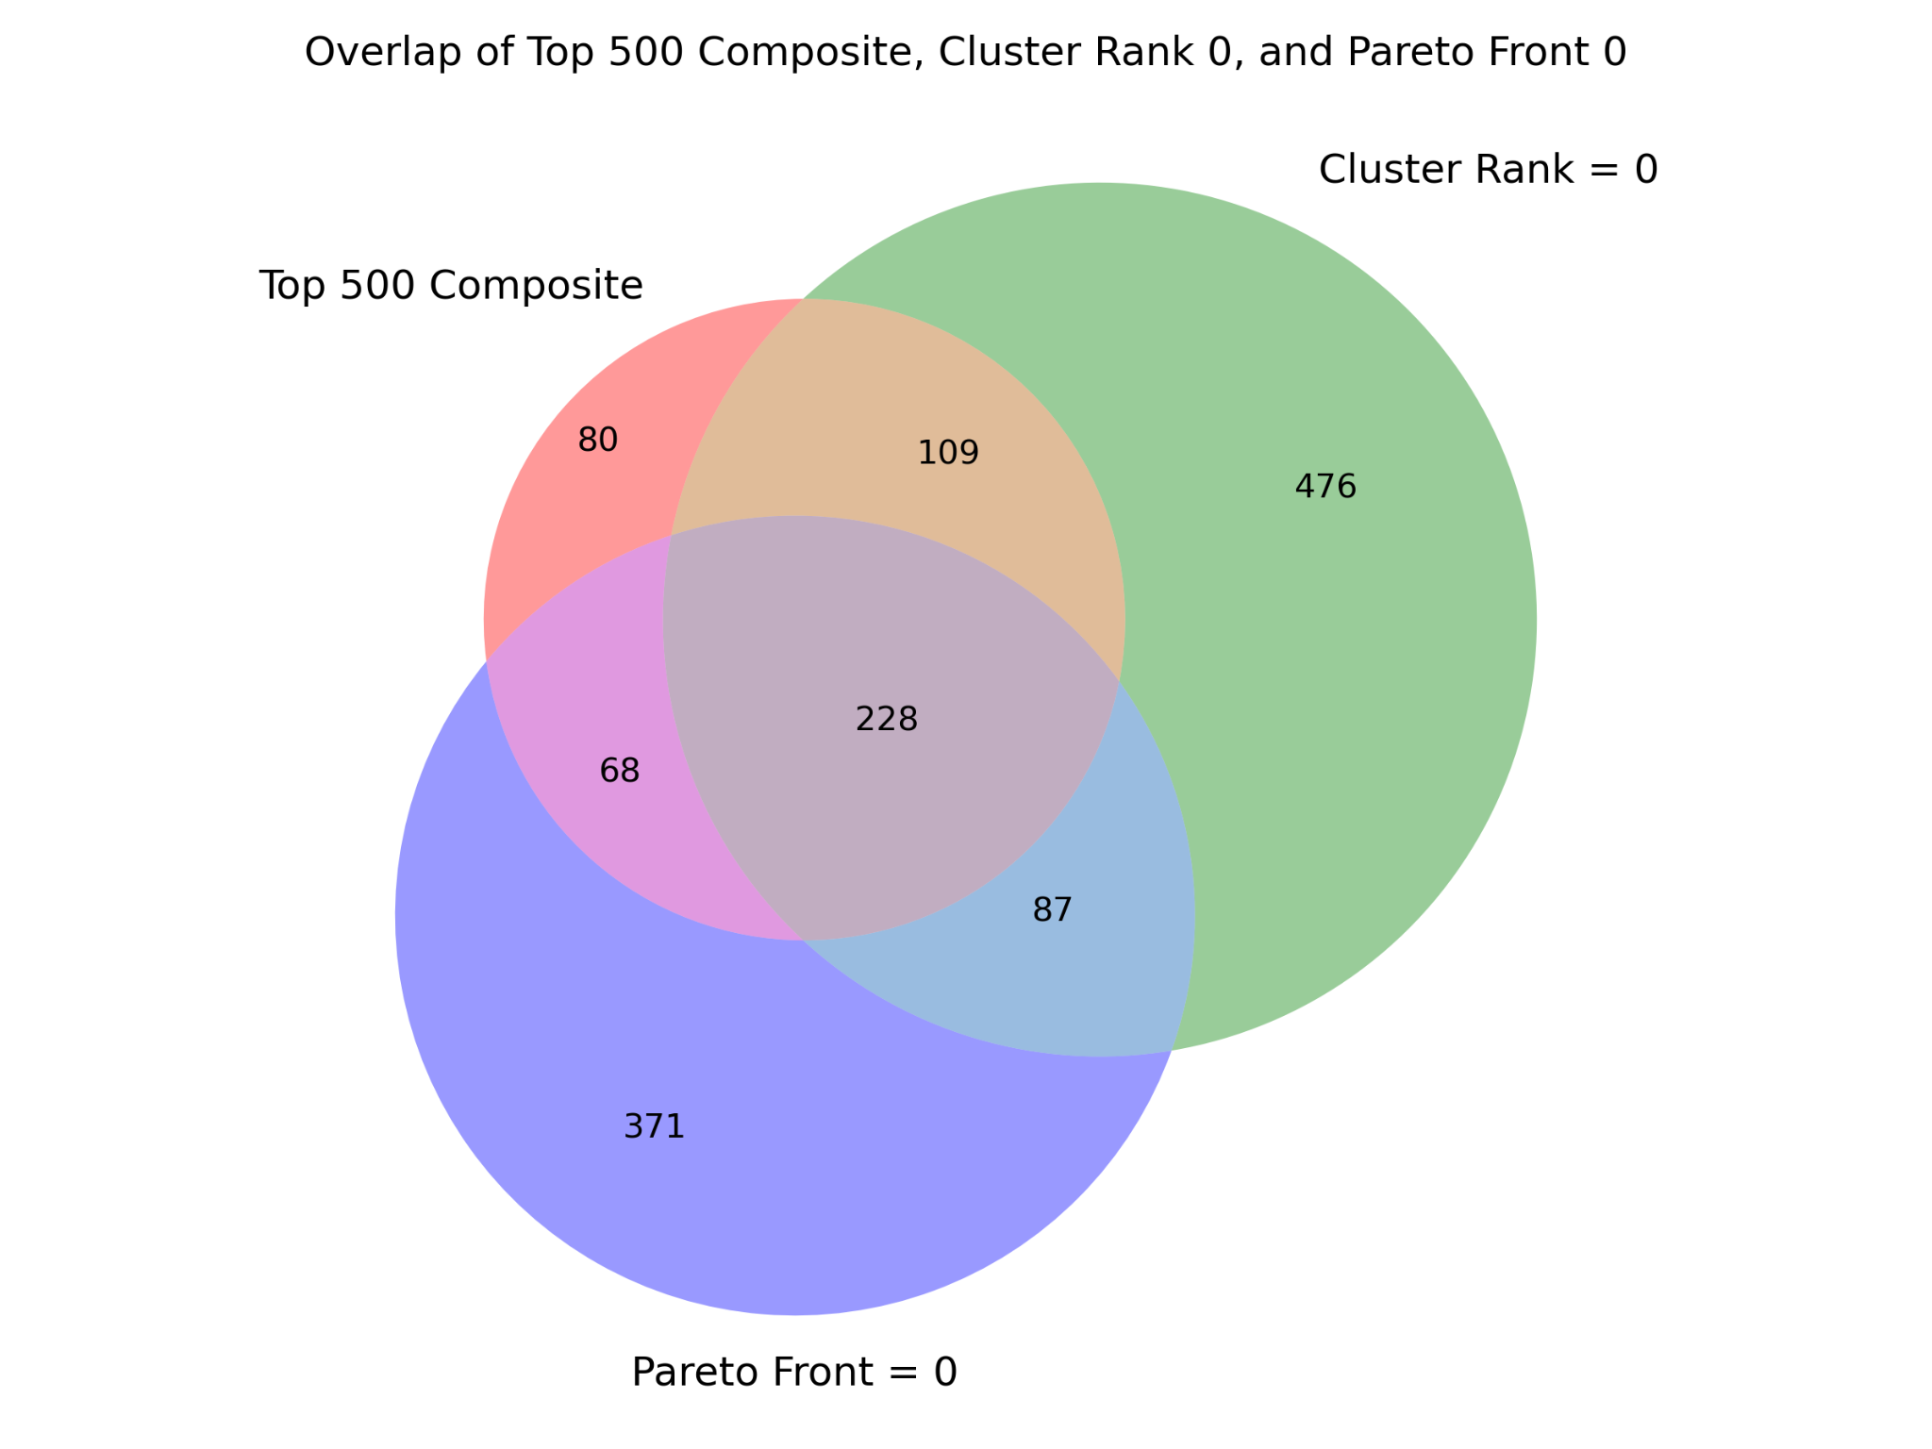
Ensemble Approach
Union of all high-impact papers
Count-based ranking across methods
Confirms robustness of selection

Slide 15

Result Snapshot
228 papers identified by all 3 methods
Dominated by health & social science themes

Slide 16
Deployment & Usage
Open-source tool: GitHub
Transparent inputs and logic
Adaptable to any institution or department

Slide 17
Limitations & Future Work
Ambiguous cutoffs
Percentile ties in sparse altmetric space
Goal: human-in-the-loop validation system

Slide 18
Conclusion
Unsupervised ≠ Unprincipled
Multi-method comparison
Institutional impact benchmarking
Interpretability + extensibility

Slide 19
Questions & Contact
Contact: met48@txstate.edu
GitHub: MariaElise-T/ResearchImpactAI
Questions?

Slide 20
Citations
Penfield, T., Baker, M.J., Scoble, R., Wykes, M.C.: Assessment, evaluations, and definitions of research impact: A review. Research Evaluation 23(1), 21–32 (2014) https://doi.org/10.1093/reseval/rvt021 . Accessed 2025-04-22
Priem, J., Taraborelli, D., Groth, P., Neylon, C.: altmetrics: a manifesto
Morton, S.: Progressing research impact assessment: A ‘contributions’ approach. Research Evaluation 24(4), 405–419 (2015) https://doi.org/10.1093/reseval/rvv016 . Accessed 2024-07-24
Ali, M.J.: Understanding the Altmetrics. Seminars in Ophthalmology 36(5-6), 351–353 (2021) https://doi.org/10.1080/08820538.2021.1930806 . Accessed 2025-04-22
Arnold, D.N., Fowler, K.K.: Nefarious Numbers. arXiv. arXiv:1010.0278 [math] (2010). https://doi.org/10.48550/arXiv.1010.0278 . http://arxiv.org/abs/1010.0278 Accessed 2025-04-23
Vaught, A.,Wagner, R.: 233 Beyond bibliometrics: Altmetric analysis as an early signal of the impact of the National Center for Advancing Translational Sciences (NCATS) Clinical and Translational Science Awards (CTSA) Program. Journal of Clinical and Translational Science 9(s1), 71–72 (2025) https://doi.org/10.1017/cts.2024.880. Accessed 2025-04-22
Elifritz, S.N..C.: Generating Impact Narratives. Elsevier. https://uknowledge.uky.edu/cgi/viewcontent.cgi?article=1036&context=research events2
Giagkiozis, I., Fleming, P.J.: Pareto front estimation for decision making. Evolutionary Computation 22(4), 651–678 (2014) https://doi.org/10.1162/EVCO a 00128 https://direct.mit.edu/evco/article-pdf/22/4/651/1530439/evco a 00128.pdf

